Slide 1

Learning Objectives
LO1 Explain the purpose of a general journal.
LO2 Account for purchases returns and allowances.
LO3 Post a general journal to the accounts payable ledger and general ledger.
© 2014 Cengage Learning. All Rights Reserved.

Slide 2
General Journal
Lesson 11-1
LO1
A journal with two amount columns in which all kinds of entries can be recorded is called a general journal.
Not every transaction can be recorded in a special journal.

Slide 3
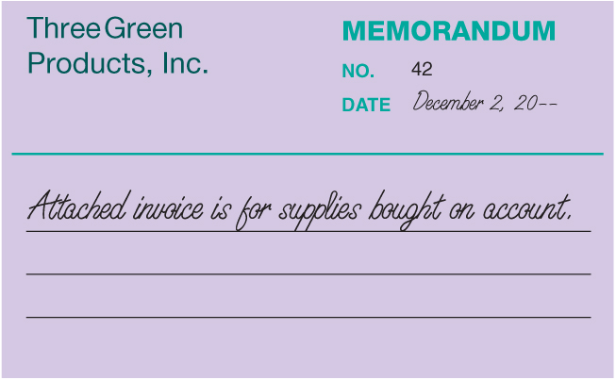
Memorandum for Buying Supplies on Account
Lesson 11-1
LO1

Slide 4
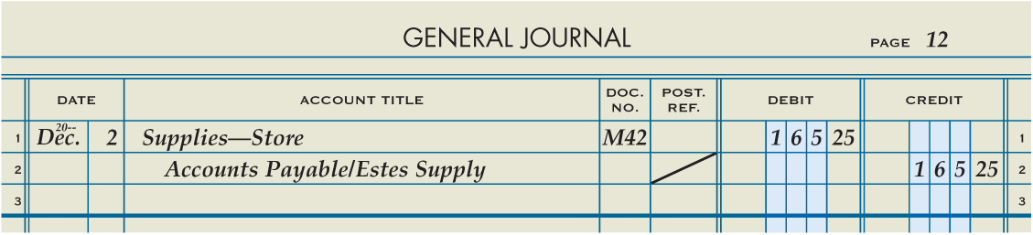
Buying Supplies on Account
Lesson 11-1
LO1
Supplies—Store
December 2. Bought store supplies on account from Estes Supply, $165.25. Memorandum No. 42.
165.25
Accounts Payable
165.25
1
Date
2
Account Title
3
Memorandum Number
5
Account Title and Vendor Name
Diagonal Line
6
4
Debit Amount
7
Credit Amount

Slide 5
Debit Memorandum for Purchases Returns and Allowances
Lesson 11-1
LO2
Credit allowed for the purchase price of returned merchandise, resulting in a decrease in the customer’s account payable to the vendor, is called a purchases return.
Credit allowed for part of the purchase price of merchandise that is not returned, resulting in a decrease in the customer’s account payable to the vendor, is called a purchases allowance.
A form prepared by the customer showing the price deduction taken by the customer for a return or an allowance is called a debit memorandum.

Slide 6
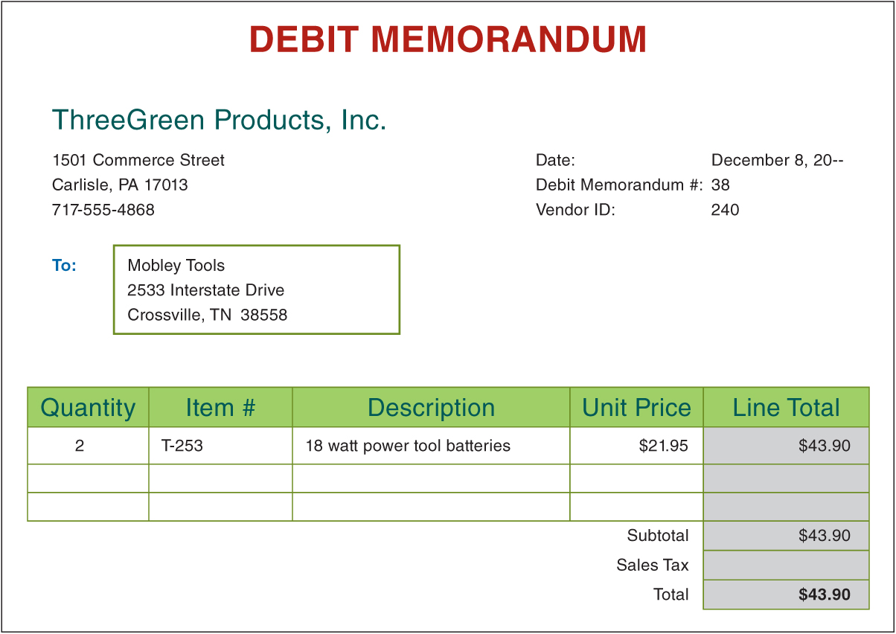
Debit Memorandum for Purchases Returns and Allowances
Lesson 11-1
LO2

Slide 7
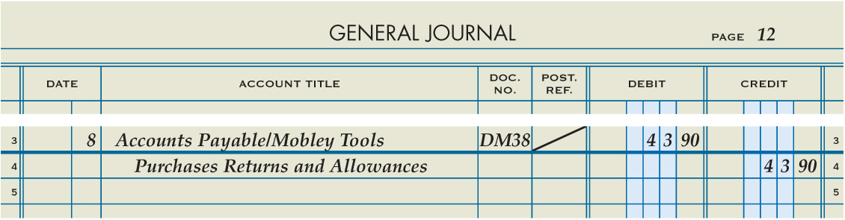
Journalizing Purchases Returns and Allowances
Lesson 11-1
LO2
Accounts Payable
December 8. Returned merchandise to Mobley Tools, $43.90, covering Purchase Invoice No. 528. Debit Memorandum No. 38.
43.90
Purchases Returns and Allowances
43.90
1
Date
2
Account Title and Vendor Name
Debit Memorandum Number
3
6
Account Title
Diagonal Line
4
5
Debit Amount
7
Credit Amount

Slide 8
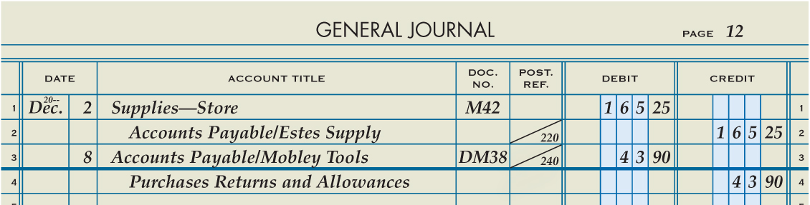
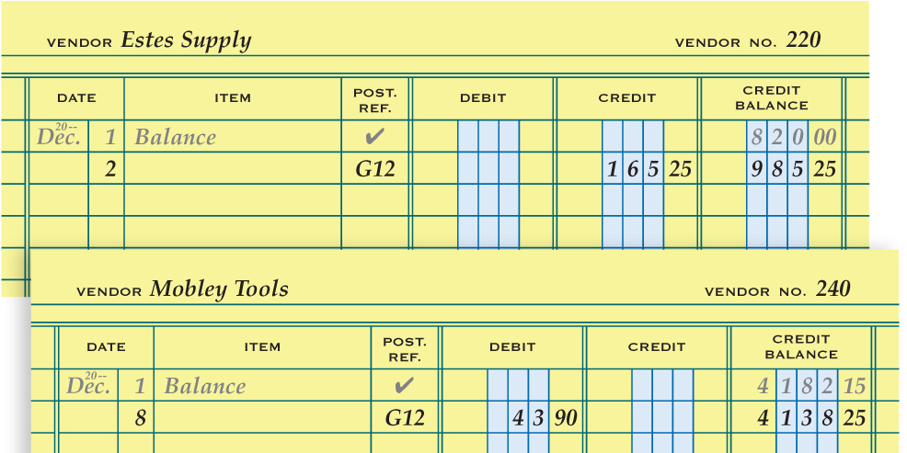
Posting from a General Journal to an Accounts Payable Ledger
Lesson 11-1
LO3
1
Date
Vendor Number
5
3
Debit or Credit Amounts
Journal Page Number
2
4
Account Balance
5
1
2
3
4

Slide 9
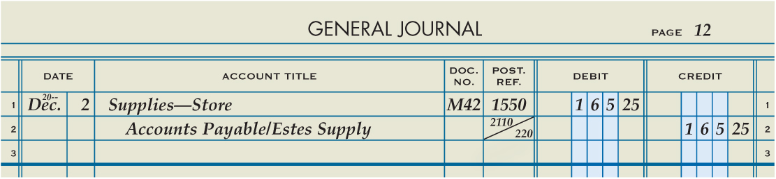
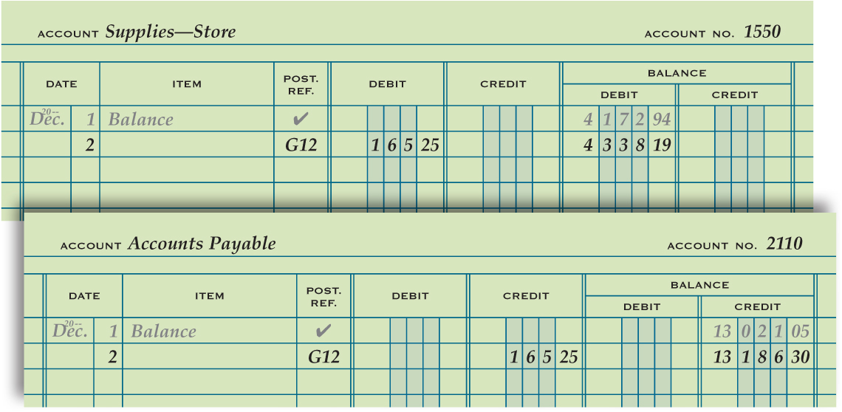
Posting from a General Journal to a General Ledger
Lesson 11-1
LO3
2
Journal Page Number
Date
1
Debit or Credit Amounts
Vendor Number
3
5
4
Account Balance
5
1
2
3
4

Slide 10

Lesson 11-1 Audit Your Understanding
Lesson 11-1
1. When is a transaction recorded in a general journal?
ANSWER
When the transaction cannot be recorded in special journal

Slide 11
Lesson 11-1 Audit Your Understanding
Lesson 11-1
2. When is the equality of debits and credits proved for a general journal?
ANSWER
After each general journal entry is recorded

Slide 12
Lesson 11-1 Audit Your Understanding
Lesson 11-1
3. What is a primary difference between a purchases return and a purchases allowance?
ANSWER
A purchases return is credit allowed for the purchase price of returned merchandise. A purchases allowance is credit allowed for part of the purchase price of merchandise that is not returned, such as for units that are damaged but still usable or of a different quality than that ordered.

Slide 13
Lesson 11-1 Audit Your Understanding
Lesson 11-1
4. If purchases returns and allowances decrease the value of Purchases,, why are returns and allowances credited to a separate account?
ANSWER
Better information is provided if purchases returns and allowances are credited to a separate account. A business can then track the amount of purchases returns and allowances in a fiscal period to evaluate the efficiency of its purchasing activities.

Slide 14
Work Together 11-1 On You Own 11-1
Work Together
11-1 (Excel)
Modeled
Page 326
On Your Own
11-1 (Excel)
Complete
Page 326

Slide 15

Learning Objectives
LO4 Account for sales returns and allowances.
LO5 Post a general journal to the accounts receivable ledger and general ledger.
LO6 Record a correcting entry to the accounts receivable ledger.
© 2014 Cengage Learning. All Rights Reserved.

Slide 16
Credit Memorandum for Sales Returns and Allowances
Lesson 11-2
LO4
Credit allowed to a customer for the sales price of returned merchandise, resulting in a decrease in the accounts receivable of the merchandising business, is called a sales return.
Credit allowed to a customer for part of the sales price of merchandise that is not returned, resulting in a decrease in the accounts receivable of the merchandising business, is called a sales allowance.
A form prepared by the vendor showing the amount deducted for returns and allowances is called a credit memorandum.

Slide 17
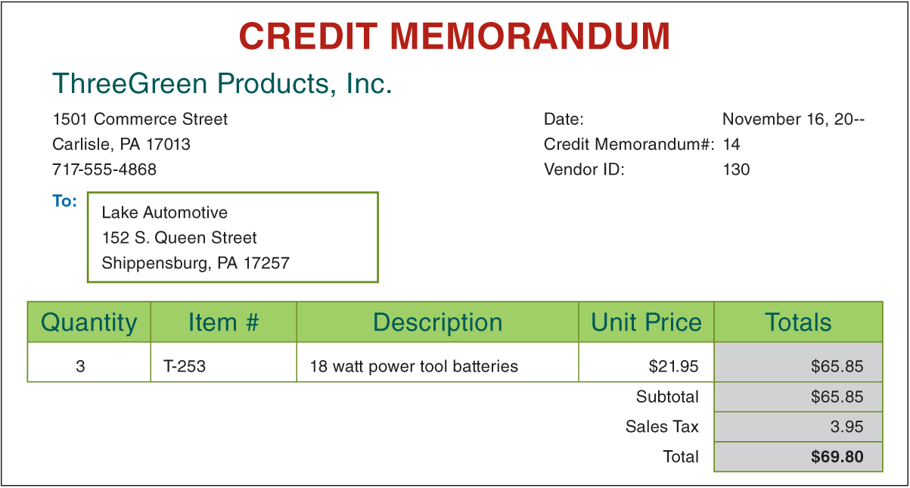
Credit Memorandum for Sales Returns and Allowances
Lesson 11-2
LO4

Slide 18
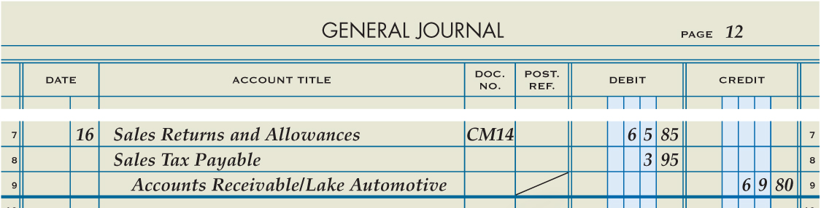
Journalizing Sales Returns and Allowances
Lesson 11-2
LO4
December 16. Granted credit to Lake Automotive for merchandise returned, $65.85, plus sales tax, $3.95, from S500; total, $69.80. Credit Memorandum No. 14.
Sales Returns and Allowances
65.85
Sales Tax Payable
1
Date
Credit Memorandum Number
3
3.95
2
First Debit Account Title
Accounts Receivable
Diagonal Line
69.80
5
Second Debit Account Title
8
6
Sales Tax Amount
7
Credit Account Titles
Sales Return Amount
4
9
Total Amount of Return

Slide 19
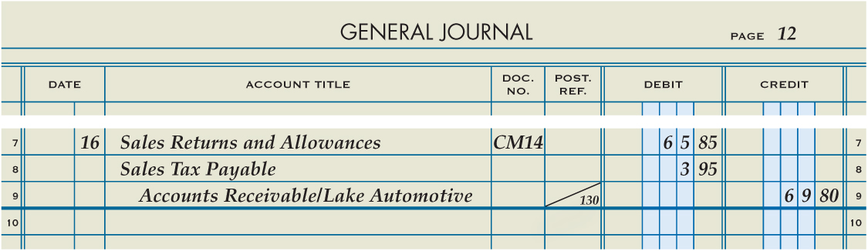
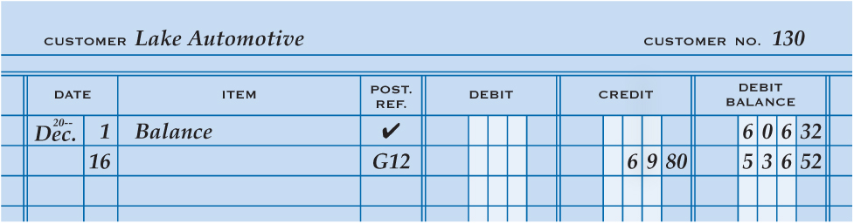
Posting from a General Journal to an Accounts Receivable Ledger
Lesson 11-2
LO5
Date
Journal Page Number
Customer Number
Credit
1
2
5
3
4
Account Balance

Slide 20
Correcting Errors in Subsidiary Ledger Accounts
Original Transaction
Debit Credit
12/23 A/R – Wells Apartments 334.00
Sales 334.00
Remains correct and no need for correction
Correction – Billed incorrect customer
12/26 Skinner College 334.00
Wells Apartments 334.00

Slide 21
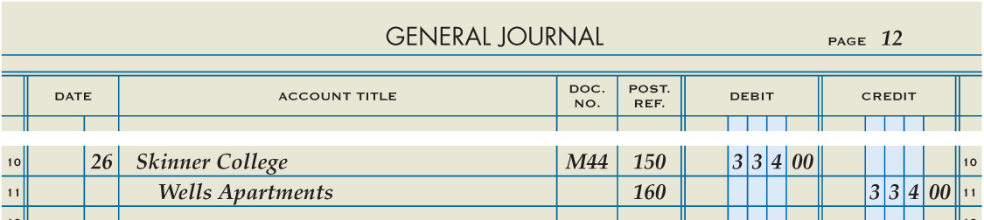
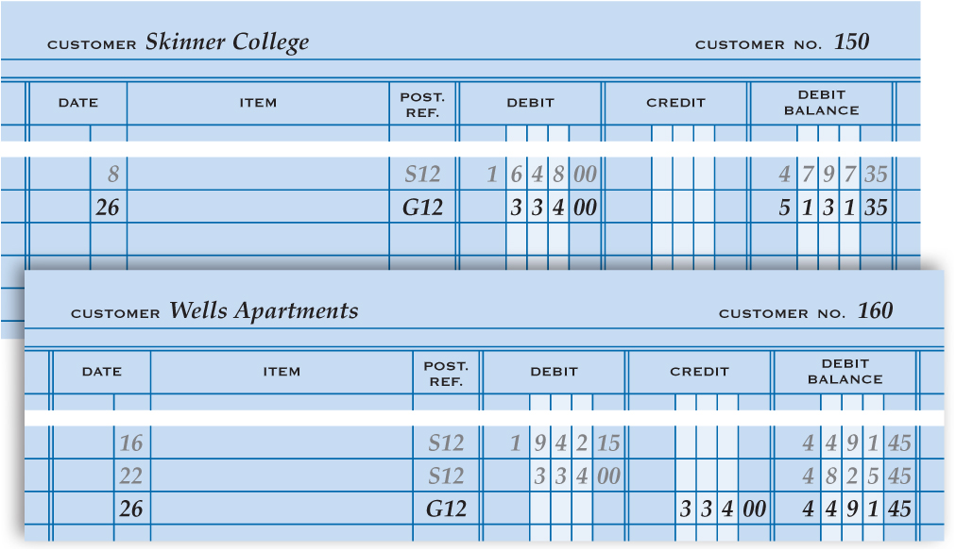
Correcting Errors in Subsidiary Ledger Accounts
Lesson 11-2
LO6
December 26. Found that a sale on account to Skinner College was incorrectly charged to the account of Wells Apartments, $334.00. Memorandum No. 44.
1. Write the date.
2. Write the name of the correct customer.
3. Write the memorandum number.
8
4. Write the amount in the Debit column.
4
5. Indent and write the name of the incorrectly charged customer.
1
2
3
6
6. Write the amount in the Credit column.
5
11
11
7. Write the date in the Date column of each customer account.
8. Write the general journal page number in the Post. Ref. column of each customer account.
7
8
9
10
11
9. Write the amount of the appropriate Debit or Credit.
10. Calculate and write the new account balance.
7
8
9
10
11. Write the customer numbers.

Slide 22
Lesson 11-2 Audit Your Understanding
Lesson 11-2
1. What is the difference between a sales return and a sales allowance?
ANSWER
A sales return is credit allowed to a customer for the sales price of returned merchandise. A sales allowance is credit allowed to a customer for part of the sales price of merchandise that is not returned, such as for a shortage in a shipment.

Slide 23
Lesson 11-2 Audit Your Understanding
Lesson 11-2
2. What is the source document for journalizing sales returns and allowances?
ANSWER
Credit memorandum

Slide 24
Lesson 11-2 Audit Your Understanding
Lesson 11-2
3. Why are sales returns and allowances not debited to the Sales account?
ANSWER
To provide better information, enabling management to quickly learn if the percent of sales returns and allowances to sales is greater than expected

Slide 25
Lesson 11-2 Audit Your Understanding
Lesson 11-2
4. Which general ledger accounts are affected, and how, by a sales returns and allowances transaction?
ANSWER
Sales Returns and Allowances and Sales Tax Payable are debited; Accounts Receivable is credited.

Slide 26
Work Together 11-2 On You Own 11-2
Work Together
11-2 (Excel)
Modeled
Page 331
On Your Own
11-2 (Excel)
Complete
Page 331

Slide 27
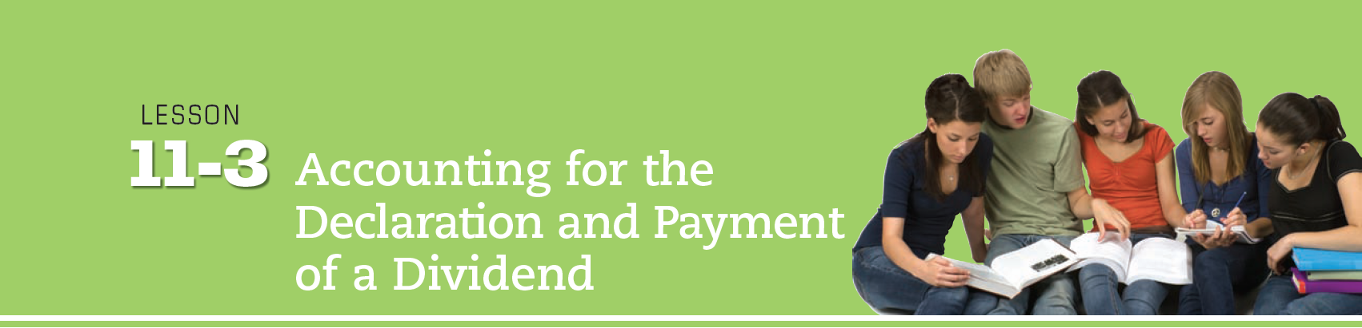
Learning Objectives
LO7 Explain the relationship between retained earnings and dividends.
LO8 Account for the declaration and payment of dividends.
© 2014 Cengage Learning. All Rights Reserved.

Slide 28
Stockholders’ Equity Accounts Used by a Corporation
Lesson 11-3
LO7
(3000) | STOCKHOLDERS’ EQUITY
3110 | Capital Stock
3120 | Paid-In Capital in Excess of Par
3130 | Retained Earnings
3140 | Dividends
3150 | Income Summary

Slide 29
Stockholders’ Equity Accounts Used by a Corporation
Lesson 11-3
LO7
An amount earned by a corporation and not yet distributed to stockholders is called retained earnings.
Earnings distributed to stockholders are called dividends.

Slide 30
Declaring a Dividend
Lesson 11-3
LO8
A group of persons elected by the stockholders to govern a corporation is called the board of directors.
Action by a board of directors to distribute corporate earnings to stockholders is called declaring a dividend.

Slide 31
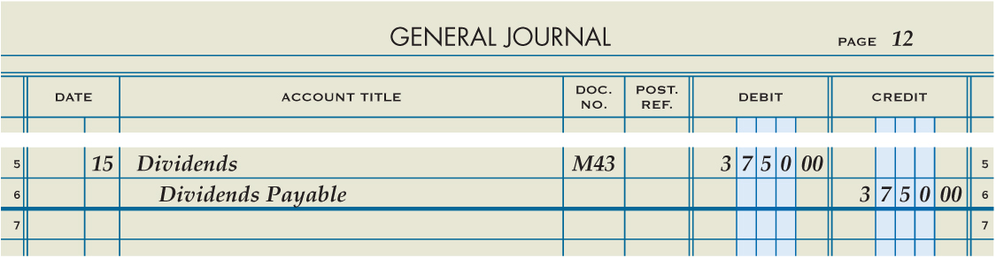
Declaring a Dividend
Lesson 11-3
LO8
December 15. ThreeGreen’s board of directors declared a quarterly dividend of $0.05 per share; capital stock issued is 75,000 shares; total dividend, $3,750.00. Date of payment is January 15. Memorandum No. 43.
Dividends
3,750.00
Dividends Payable
3,750.00
2
Account Debited
3
Memorandum Number
1
Date
5
Account Credited
Debit Amount
4
6
Credit Amount

Slide 32
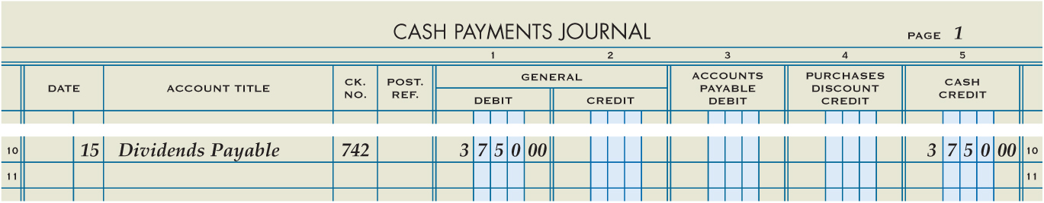
Paying Declared Dividends
Lesson 11-3
LO8
January 15. Paid cash for quarterly dividend declared column.
Dividends Payable
04/15 Paid 3,750.00
03/15 Paid 3,750.00
07/15 Paid 3,750.00
06/15 Paid 3,750.00
10/15 Paid 3,750.00
09/15 Paid 3,750.00
01/15 Paid 3,750.00
12/15 Paid 3,750.00
Cash
01/15 Paid 3,750.00
2
Account Title
4
Debit Amount
1
Date
3
Check Number
5
Credit Amount

Slide 33
Lesson 11-3 Audit Your Understanding
Lesson 11-3
1. Under what major chart of accounts division are the owners’ equity accounts for a corporation normally listed?
ANSWER
Stockholders’ Equity

Slide 34
Lesson 11-3 Audit Your Understanding
Lesson 11-3
2. Why is only one account maintained for the investment of all owners of a corporation?
ANSWER
Most corporations have many stockholders. It is not practical to have a separate owner’s equity account for each stockholder.

Slide 35
Lesson 11-3 Audit Your Understanding
Lesson 11-3
3. Which account does a corporation use to record earnings not yet distributed to stockholders?
ANSWER
Retained Earnings

Slide 36
Lesson 11-3 Audit Your Understanding
Lesson 11-3
4. How and when do net income and dividends impact permanent stockholders’ equity accounts?
ANSWER
At the end of the fiscal period, temporary accounts are closed to Retained Earnings. Net income increases Retained Earnings; dividends reduce Retained Earnings.

Slide 37
Lesson 11-3 Audit Your Understanding
Lesson 11-3
5. What action is required before a corporation can distribute income to its stockholders?
ANSWER
The board of directors must declare a dividend.

Slide 38
Work Together 11-3 On You Own 11-3
Work Together
11-3 (Excel)
Modeled
Page 336
On Your Own
11-3 (Excel)
Complete
Page 336

Slide 39
Application Problems
11-1 Application Problem
Excel
11-2 Application Problem
Excel
11-3 Application Problem
Excel

Slide 40
Application Problems
11 Mastery Problem
Peachtree
11 Challenge Problem
Peachtree

Slide 41
Unit 11 Assessment
Unit 11 Review (ExamView)
90 % or Greater
5 Point Bonus on Unit 1 Concept Quiz (20% Bonus)
Unit 11 Part 1 Quiz (ExamView)
Concepts – 25 Questions (25 Points)
Unit 11 Part 2 Quiz (Excel)
Skills (50 Points)
Understand Subsidiary Ledgers, Controlling Accounts, and creating Schedules of A/R and A/P

